Slide 1

Case Study
Software Architecture
3rd Year – Semester 1
Lecture 7

Slide 2
Schedule
19th March – Project Groups Initiation
2nd April – Case Study Distribution
9th April – Group Registration
Submission of Topic (3 topics)
Registration of Students for the Groups (5 Students per Group)
23rd April, 30th April and 7th May – Progress Reviews
14th May – Viva (Lecture, Tutorial and Lab Sessions) 20 marks
21st May – Final Report Submission 20 marks

Slide 3
What is a Case Study?
An intensive analysis of an individual unit/item/situation
Produce a detailed specialized report (non-generalized)
You'll be conducting qualitative research to find specific details of how your subject is affected
Study outcome may stresses factors contributing to its success or failure
Eg: Civilian casualties in 9/11 attack
Notes:
Study outcomes may also include: Recommendations, Observations, Comments, etc…

Slide 4
The Basics
Subject: Choose the situation on which to write
Facts: Gather as much information as possible about the situation
Analyze: Analyze all of the elements surrounding the situation
Evaluate: Determine the final solution implemented
Conclude: Identify why the solution worked or did not work
Notes:
Subject = Topic or Case
Evaluate = Process or Execute
Conclude = Show the strength and weaknesses, etc…

Slide 5
Scope
Narrow down the scope of your case
Eg:
Education
Education in Sri Lanka
Higher Education in Sri Lanka
Private Universities/Institutes in Sri Lanka
… more specific …
Notes:
The Quality of the XYZ course of the ABC institute

Slide 6
Topic Selection
This academic case study is about an intensive analysis about a Software System with respect to a Single Quality Attribute
E.g. Scalability of Facebook's Architecture
Software/System → Facebook
Quality Attribute → Scalability

Slide 7
Topic Selection – Rules
1 topic per group on First come first serve basis
A group may propose more than 1 topic if they are unsure if other groups have already taken that topic or if the proposed topic does not qualify for a case – however only 1 has to be finalized and register
No more than 4 groups should select Cases for the Same Domain and Same Quality Attribute for their study
It’s at the discretion of the Lecture to Approve/Reject the topic if…
Other groups have taken a similar topic
Case/Scope is not compelling enough to conduct a study
Notes:
The Lecturer will provide help for topic selection if needed

Slide 8
Topic Selection – Domains
A Group must select a Software System that belongs to one of the following domains
Social Networks
Mobile Software / Platforms
Enterprise / Cloud Software
IoT Software / Platforms
NOTE: Domains that are not listed above can be selected only under special circumstances and subjected to special approval

Slide 9
Topic Selection – Quality Attributes
A Group must select a Quality Attribute from following for their Case Study for the selected Software System
Performance
Reliability
Security
Scalability
Interoperability
NOTE: Quality Attributes that are not listed above can be selected only under special circumstances and subjected to special approval

Slide 10
Expectations
Case study should include background information on the specific topic, an analysis of the case under study showing problems or effective strategies, as well as recommendations
Analyze
How the chosen Quality Attribute have improved or worsened overall Quality of the System under consideration, how did the architecture evolved to support that?
Your findings
What has been done to improve the chosen quality attribute of the system
What other Quality Attributes were affected? and how so?
What are the Trade-offs made? What are the implications?
Your judgement/recommendations/suggestions
Compare
Compare with competitor systems in the same domain and different domains and identify how the Quality Attribute under consideration helped to stay competitive (or why this particular system lost out to the others)

Slide 11
Report Format Guideline
Abstract/Executive Summary
Key points/findings
Introduction
Current Situation Analysis and pertinent Background including a synopsis of the relevant information from the case analysis tool short form
Analysis
Market needs, Key issues/goals, Decision criteria, Assumptions, Data Analysis, Alternatives & considerations, Justification/predicted outcome
Conclusion
References
Appendices

Slide 12
Any type of plagiarism is not allowed.
Plagiarism: Academic honesty is crucial to a student’s credibility and self-esteem, and ultimately reflects the values and morals of the Institute as whole. A student may work together with one or a group of students discussing assignment content, identifying relevant references, and debating issues relevant to the subject. Plagiarism occurs when the work of another person, or persons, is used and presented as one’s own.

Slide 13
Group Registration
5 Students per group
Exceptions are allowed on case by case basis
Topic
Students are allowed to propose 3 topics
Registration only for 1 topic
Later changes to the topic is highly discouraged and based on availability
Deadline – 9th April 2017

Slide 14
Viva & Report Evaluation
Although this is a group assignment , individuals will be assessed on their performance.
Viva Deadline – 14th May 2017
Groups should register for a Viva/Evaluation timeslot 1 week ahead of the Viva Deadline
Each member should be present for the Viva
A draft copy of the Final Report should be presented at the Viva for feedback
Final Report Submission Deadline – 21st May 2017

Slide 15
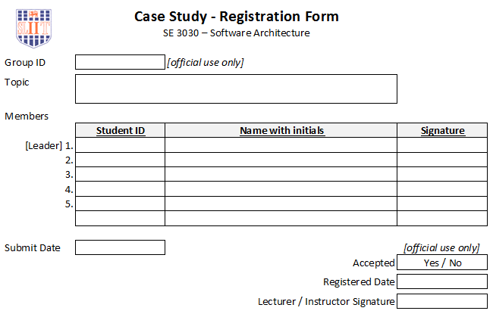
Group Registration Form
Please refer to Course Web

Slide 16
Recommended Reading
http://www.monash.edu.au/lls/llonline/quickrefs/27-case-study.pdf
http://www.wikihow.com/Do-a-Case-Study

